Slide 1
Are Exotic Plant Invaders All That Bad?
Curriculum activities based on a research project investigating the comparative effects of native and exotic plants species in Indiana Dunes National Lakeshore ponds

Slide 2
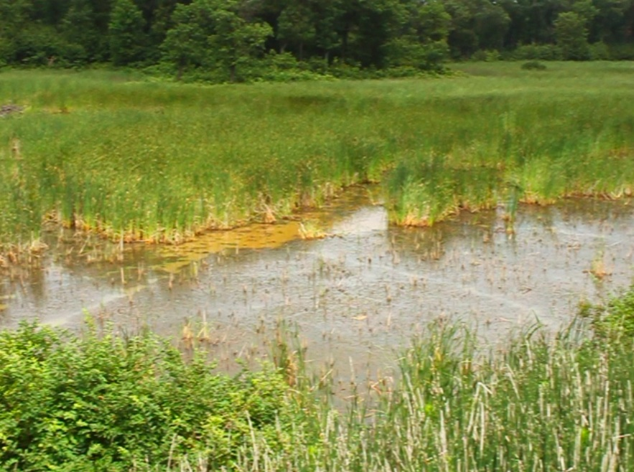
The Problem with Exotic Species
Part I:

Slide 3
The Problem with Exotic Species
According to the Environmental Protection Agency exotic species are non-native plants or animals deliberately or accidentally introduced into a new habitat outside of the habitats where they evolved.

Slide 4
Exotic species plants, also called alien, introduced, or non-indigenous species are thought to be a leading cause of biodiversity loss in many aquatic ecosystems.
Once introduced to a new habitat, exotic species are able to reproduce and survive often unhindered by competitors or predators.

Slide 5
The Problem with Exotic Species
This is Typha x glauca also known as a cattail, which is an exotic invasive species in the Indiana Dunes, and one of the species Lee was interested in studying.

Slide 6
Typha angustifolia
Typha x glauca is actually a hybrid between two other species of cattail: this Typha angustifolia which is not native to the Indiana Dunes and Typha latifolia

Slide 7
Typha latifolia
Typha latifolia is native to the Indiana Dunes.

Slide 8
Typha x glauca
Typha x glauca is considered an invasive exotic species, meaning that not only was it not normally found here, but once introduced it disrupts the ecosystem by spreading aggressively with very few natural predators to hold it back.

Slide 9
When Typha angustifolia arrived here to the ponds where Typha latifolia lived, the two cattails shared enough genetic material to interbreed, and a new hybrid was born, which is the cattail we see here. Armed with the traits from both parents.

Slide 10
Phragmites australis, or common reed, is another exotic invasive plant species in the Indiana Dunes.
A relative of Phragmites was native to our country, but the type from Europe is so similar to its American cousin that it can be only distinguished by DNA testing.

Slide 11
Phragmites australis is also unique because it secretes gallic acid, which is broken down by UV light from the sun into mesoxalic acid. The combination of these two toxins proves to be a deadly mix for young plants trying to get started in the wetlands.

Slide 12
The European common reed is one of the biggest invaders into urban wetlands because it thrives in the high salt concentrations where humans salt the roads in winter.

Slide 13
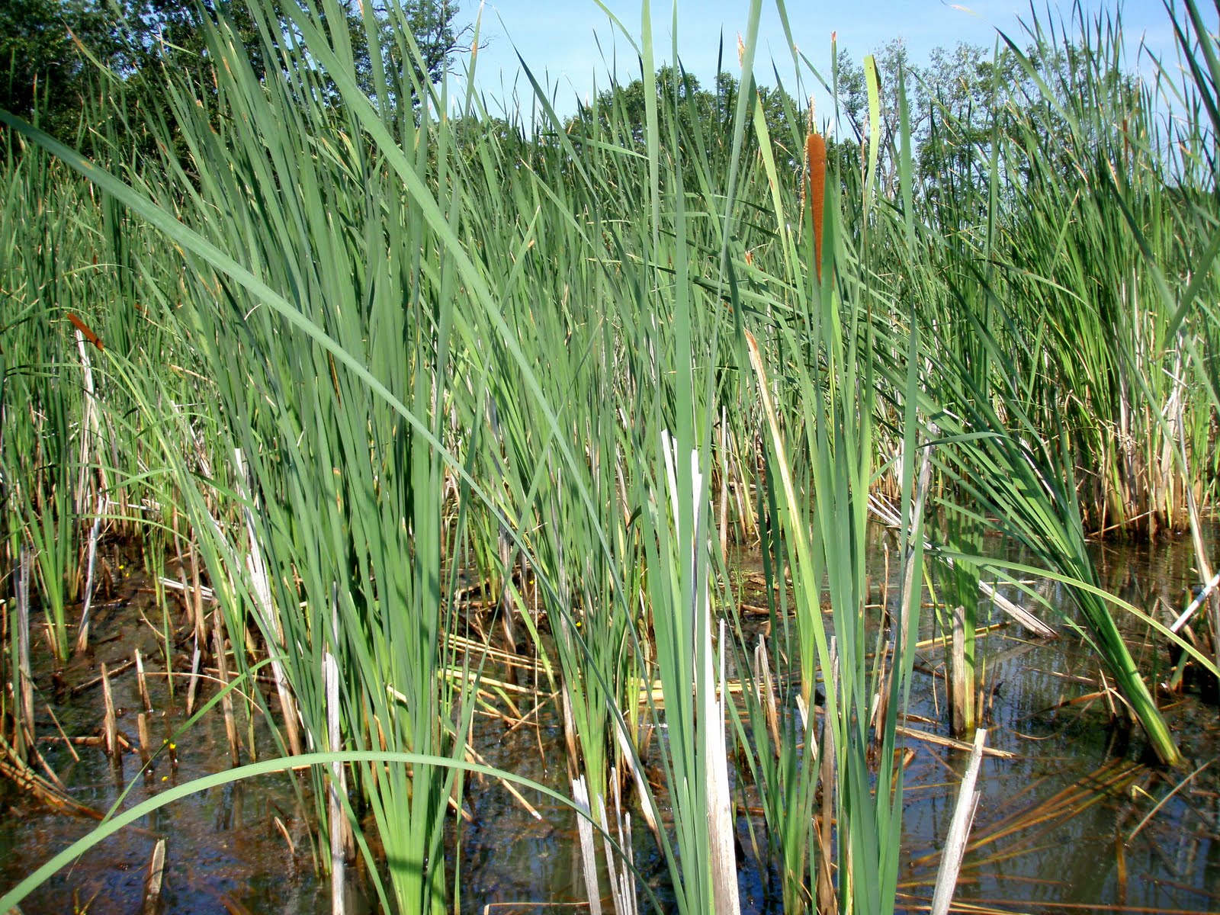
Both Typha X glauca and Phragmites australis grow in dense patches, or stands, in wetland areas. As the patch spreads it blocks out sunlight for other plants in the area forming what could be called a monoculture, which is an area where one species dominates. In addition to space and light, Typha and Phragmites also monopolize nutrients that other organisms need to survive. All of these resources can be called limiting factors, and these resources become more limited at higher population levels. For example, ten individuals need more food, water, and other resources than one. This is called density-dependence.

Slide 14
In this plot, a closer look would reveal that there are some plants at or just below the water’s surface that have managed to survive, but for how long?

Slide 15
Most park management officials and conservation biologists believe that an exotic invasive species like these cattails cause problems by displacing native species through competitive exclusion. Some native species can even go locally extinct.
There is plenty of research going on to show how exotic invasive species replace native species in ecosystems.

Slide 16
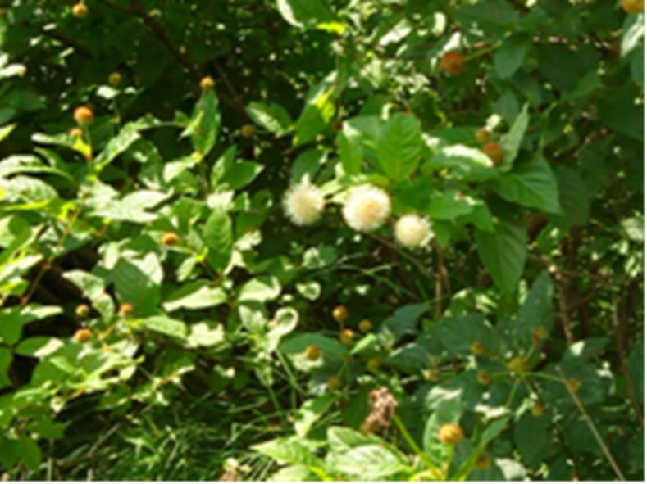
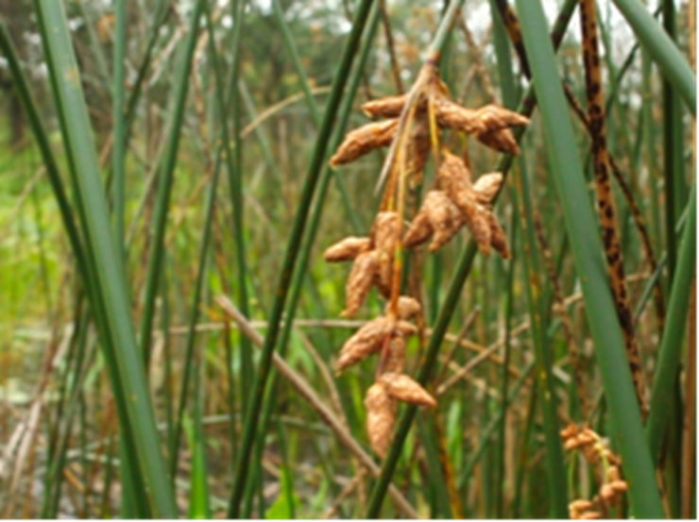
However, there are plants that are native in the Indiana Dunes pond system that form dense stands a lot like the exotic invaders!
Examples of native species that form resource depleting monocultures are Cephalanthus occidentalis and Schoenoplectus acutus.

Slide 17
This is Cephalanthus occidentalis, known as buttonbush. It gets its name from these button-like flowers. Buttonbush is a native plant that forms dense patches in the wetlands of the Indiana Dunes too!

Slide 18
Schoenoplectus acutus, or hardstem bulrush, is another native species growing in these dense stands and shading out sunlight from the plants beneath.

Slide 19
Why aren't park managers worried about these species taking over wetlands too? Though they form dense patches, buttonbush and bulrush don't reproduce or spread as rapidly as an invasive species so the patches are smaller and fewer.
Even so, these dense patches do seem to have a way of taking over the resources of an area and don’t seem to let much of anything else grow there.

Slide 20
So why doesn’t anyone want to chop these down? If native species can form dense stands that deplete the community of limited resources just like exotic species, why do we try to destroy the exotic species but not the native species? Aren’t the native species just as bad?

Slide 21
To find out, Lee Stevens a student at Brown University in Providence, RI majoring in Biology, traveled to Indiana Dunes National Lakeshore during the summer between her junior and senior years.
Lee designed her research around comparing the effects of the exotic species and the native species we've just learned about on their immediate environments in the Miller Woods pond system , and the plants that live in them to provide a better understanding about the way local species extinctions are caused by invasives.

Slide 22
The Miller Woods ponds are a valuable place for research because we have accumulated a lot of information about them from research over the years. For example, we know exactly which species were growing in some of these ponds over thirty years ago! This amount of available data is why many scientists, like Lee, choose to do research here.

Slide 23
The Miller Woods are home to 150 ponds that are the last remnants of a once- extensive pond system. The ponds formed in rows as Lake Michigan receded to the North after glaciers started melting 15,000 years ago.

Slide 24
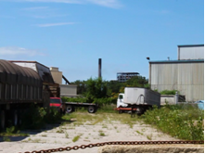
Although ecologists like Henry Cowles reported upwards of 50 rows of ponds in the area in the early 1900s, only a few remain today with the rest having been taken over by industry and housing.

