Slide 1
Are Exotic Plant Invaders All That Bad?
Part II
The Research Project: Exotics Verses Natives

Slide 2
The competitive exclusion principle tells us that when two species occupy the same niche, in the same habitat, at the same time, they will compete until one becomes locally extinct. After all, there are only a limited amount of resources like sunlight and nutrients available to go around, and if the invasive exotics aren’t sharing, someone’s going to suffer!

Slide 3
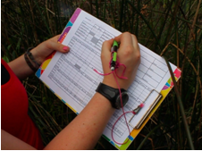
Lee wanted to find out if these exotic "bad guys" were really all that bad. As you've already seen, some native species have similar effects on the ecological community; so Lee began to compare the two groups.

Slide 4
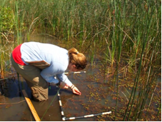
First, she found ponds that had large patches of the target species. She marked out areas within these patches of equal size, called quadrats, and counted the varieties of other plant species that were found growing it to see if the invasive species caused a decrease in biodiversity.

Slide 5
Lee recorded the quality of health of some species to see if buttonbush, bulrush, cattails, or common reed changed how well other plants were doing. To measure health, she compared each species' biomass, which was estimated by recording the number of plants, how tall they were, and the size of their leaves. This helped to determine if plants had enough resources to allow them to grow.

Slide 6
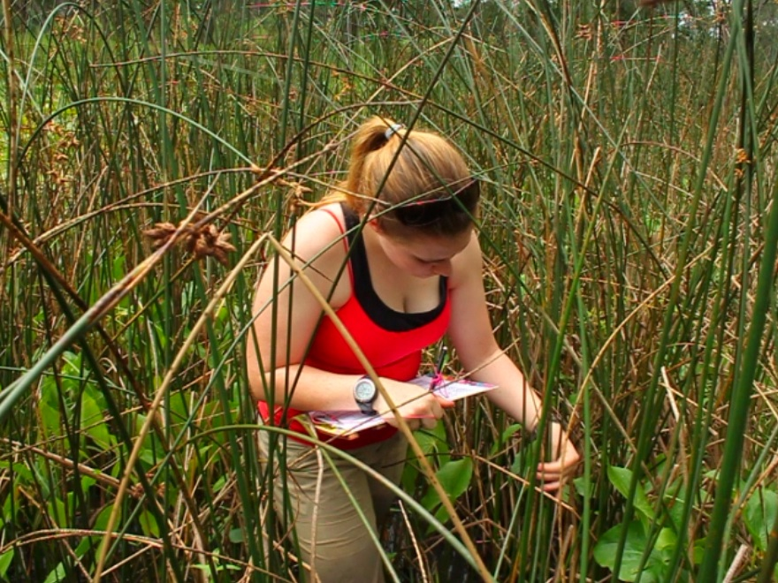
She also recorded if the plants were flowering or seeding, which are signs of reproduction. If plants in an area are reproducing, it shows that they are biologically fit. Their ability to produce viable offspring means they are passing their genes on to the next generation.

Slide 7
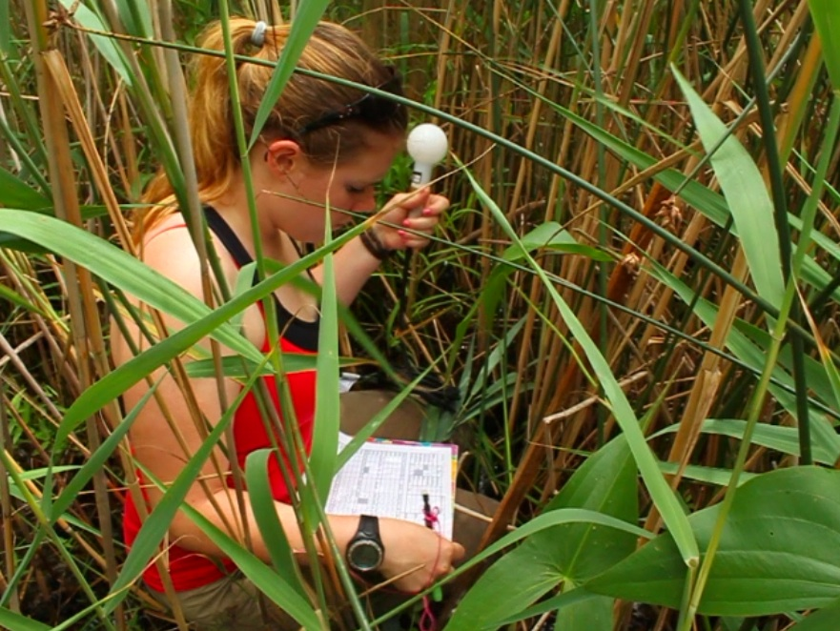
To measure resources that might be limiting plant growth, she also recorded the amount of light reaching the water surface with a light meter. Since light is a limiting factor for all plants, the amount of light that is able to reach through the dense stand can be an important factor that determines the health of those that are able to survive.

Slide 8
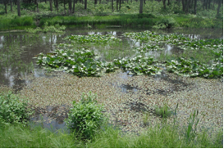
Since all scientific experiments need to have a control group as a basis of comparison, she recorded the same measurements in areas free from dense patches of tall plants. There she could see how the plants would grow if these populations didn't block out the sun or take up other limiting resources, and show even more similarities and differences between the exotic plants and the native monoculture species.

Slide 9
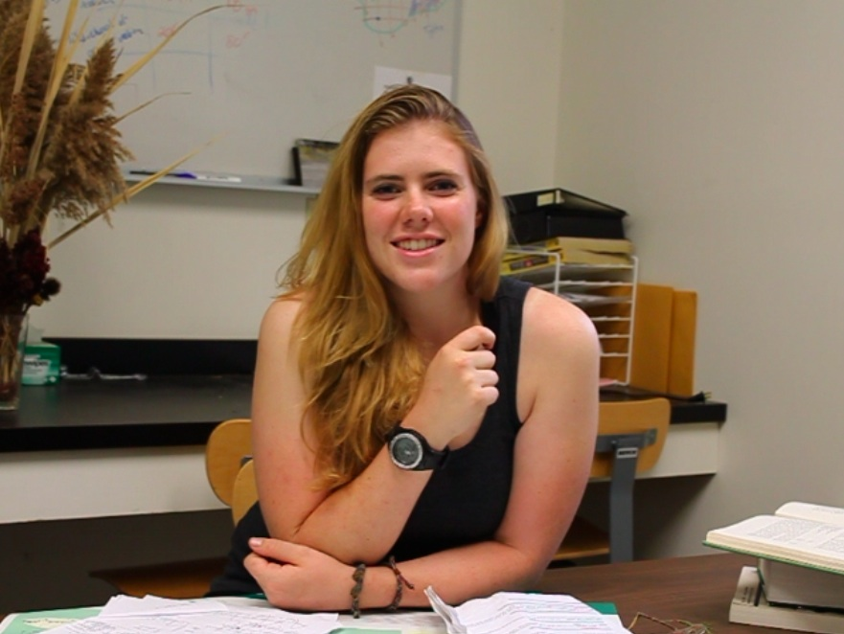
What do you expect to see in the results when we compare the native monoculture quadrats to the exotic species quadrats? Do you think the areas in the native species patches will have higher biodiversity and healthier plants than those found with exotic species quadrats, or the opposite? Why? How will the native and exotic patches compare to the relatively open areas?

